Slide 1
Neighborhood Attention Transformer
南京恩博科技算法部：汤庆飞
https://arxiv.org/abs/2204.07143
https://github.com/SHI-Labs/Neighborhood-Attention-Transformer

Slide 2
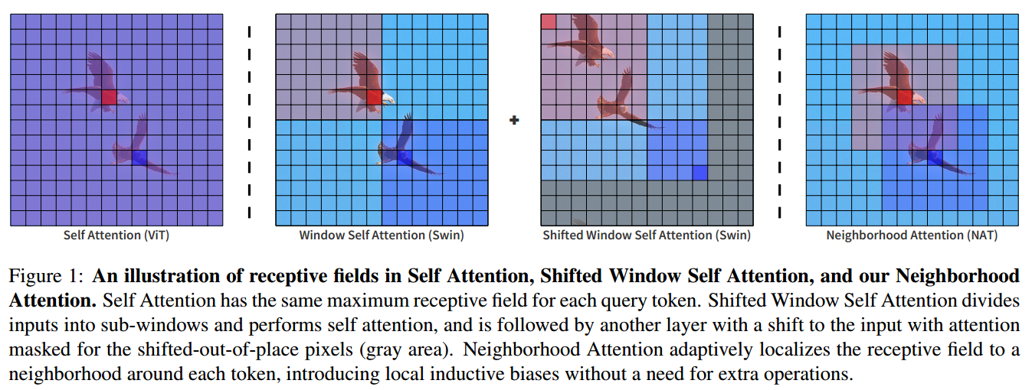
NAT

Slide 3
NAT
VIT结构存在的问题
Token数量相对图像分辨率具有二次复杂度，高分辨率图像将会带来复杂度和内存的二次增长，对需要高分辨率图像的目标检测和分割任务带来挑战
VIT只在MLP中获得局部性和平移不变性
NAT的优势
提出Neighborhood Attention[NA]模块，将query token的感受野限制在token周围的一个固定大小的邻域内，加入位置偏差，解决局部性和平移不变性，降低计算复杂度
提出Neighborhood Attention Transformer[NAT]结构，通过设计类似卷积的分层次的结构，在每层做2倍下采样，将空间大小减小一半，降低计算复杂度

Slide 4
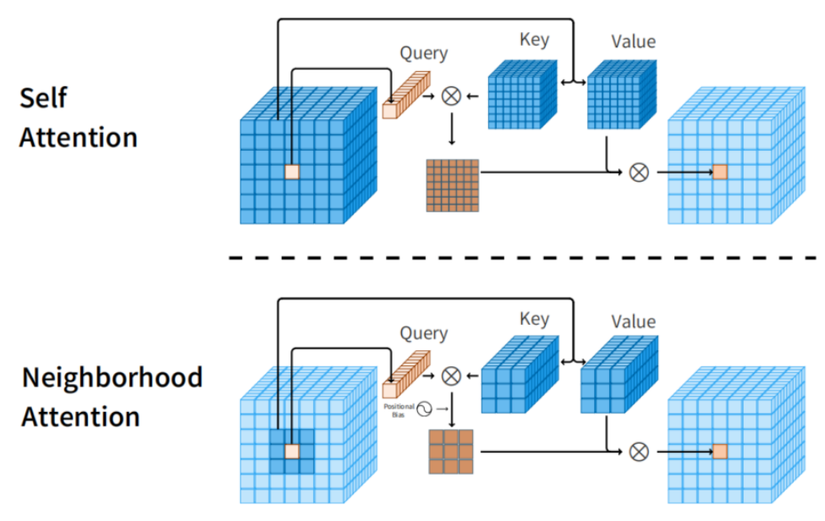
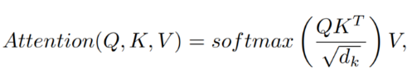
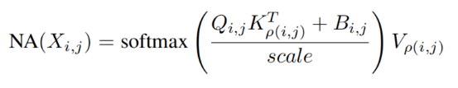
NA
P(i,j)表示(i,j)处的一个像素的邻域
B(i,j)表示相对位置偏差

Slide 5
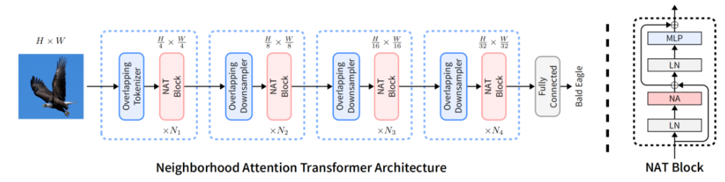
NAT
1、NAT第一层采用2个3x3（stride=2）卷积将输入图像大小H x W缩放至H/4 x W/4
2、下面三层，每层接一个下采样器，做2倍下采样，token维度做4倍下采样

Slide 6
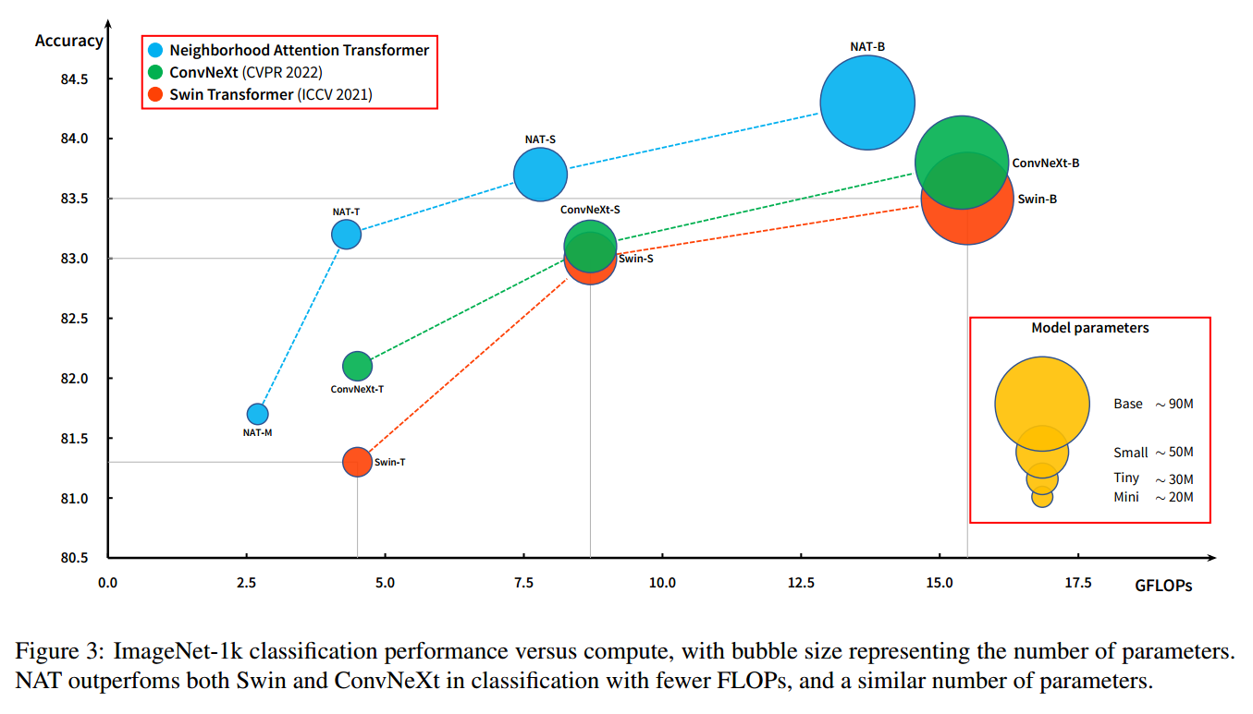
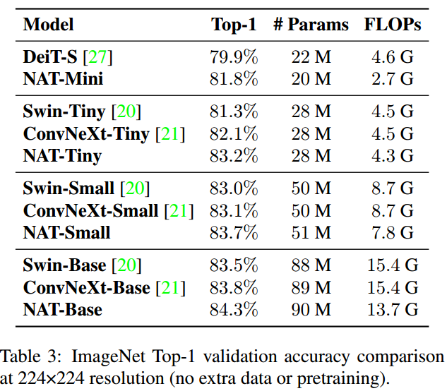
NAT

Slide 7
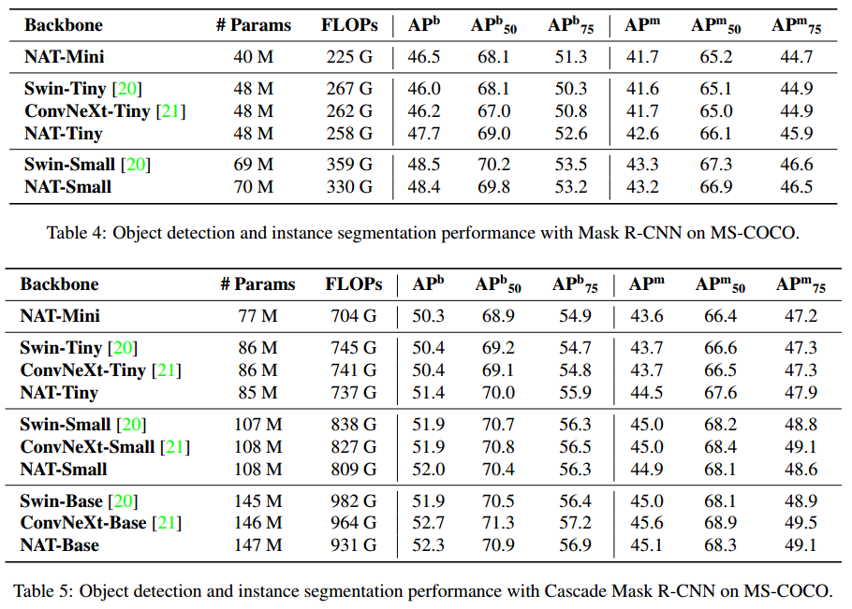
NAT

Slide 8
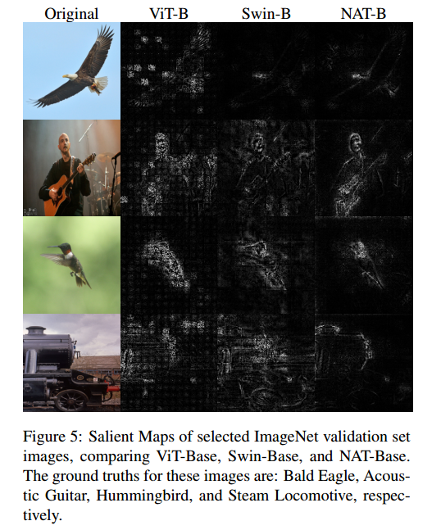
NAT
From these salient maps we can see that all models have relatively good interpretability, though they focus on slightly different areas. NAT appears to be slightly better at edge detection, which we believe is due to the localized attention mechanism, that we have presented in this work, as well as the convolutional tokenizer and downsamplers

Slide 9
Q&A

